Slide 1
ARTA
Hololens
HDD System
Manual Control
World Camera
Camera Stream
YOLO
Navigation
World Manager
YACHT Tracker
Reactive Control
ARTA Manager
Visuals
YACHT Direction

Slide 2
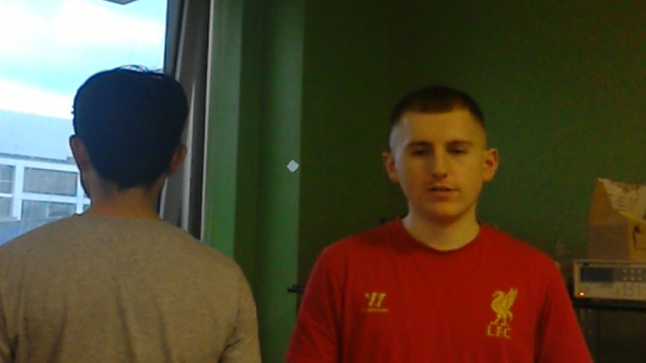
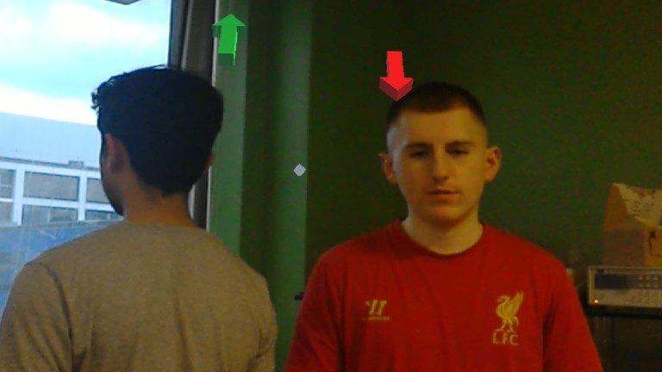
Hololens Unity Application
Hololens World View
HoloCamera
JPG Image
World Camera
Vulcan CameraStream
JPG Encoding
HDD Data
ARTA Manager
World Manager
Holograms
ARTA Topics
World Positions of People
Displayed Holograms
HoloWorld

Slide 3
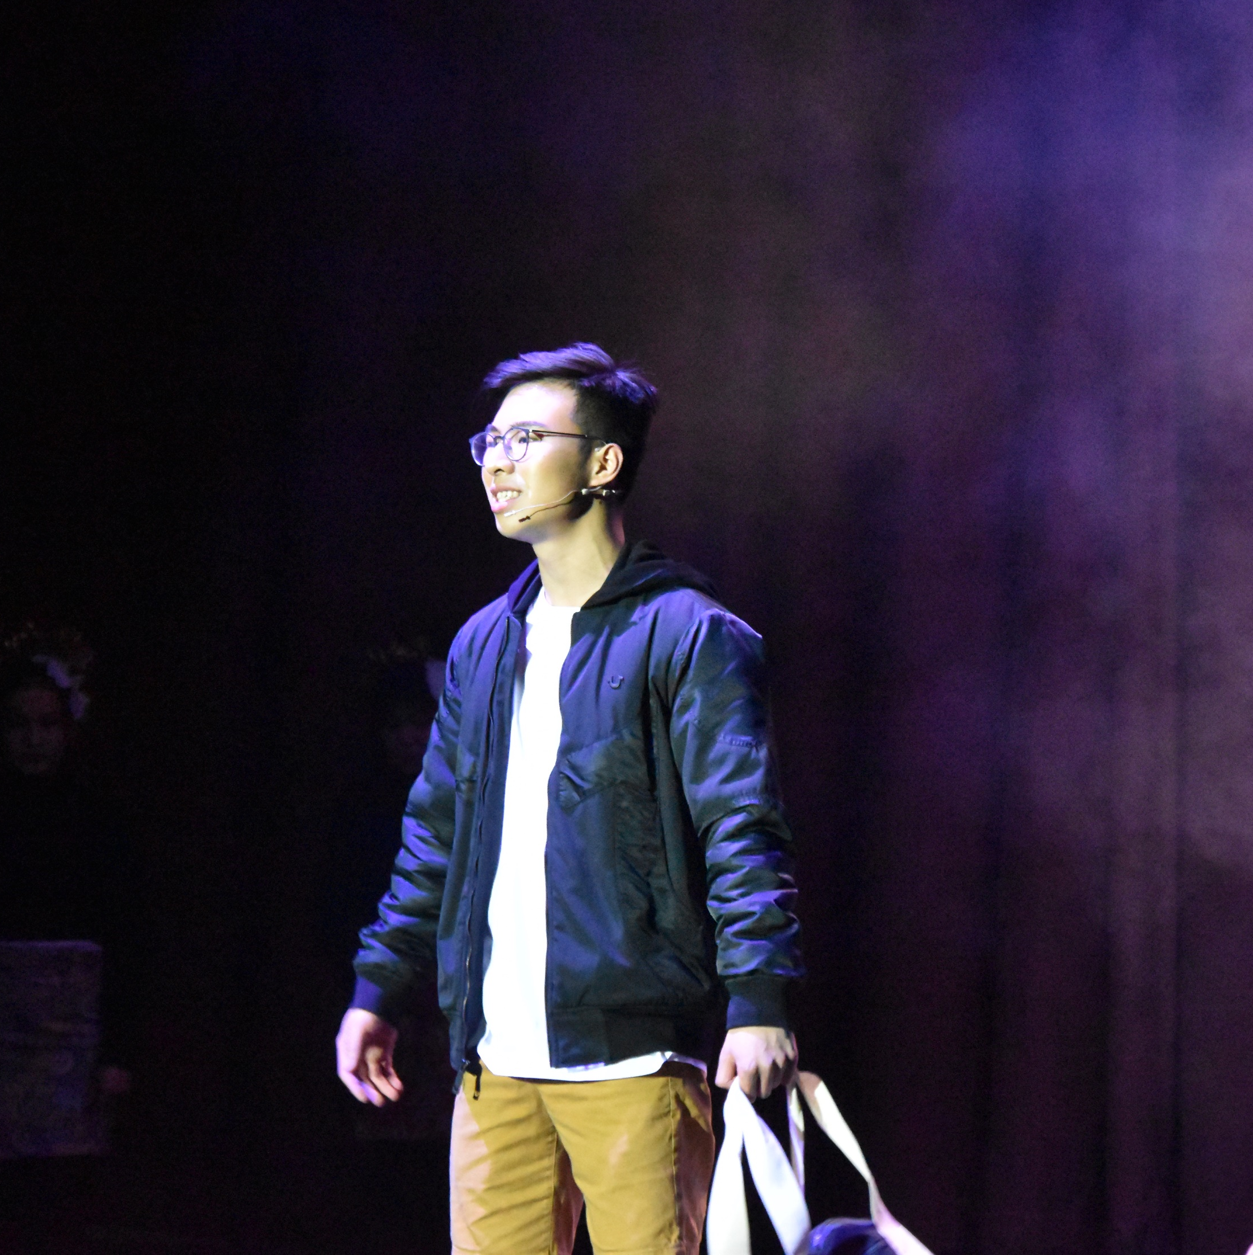
person

Slide 4
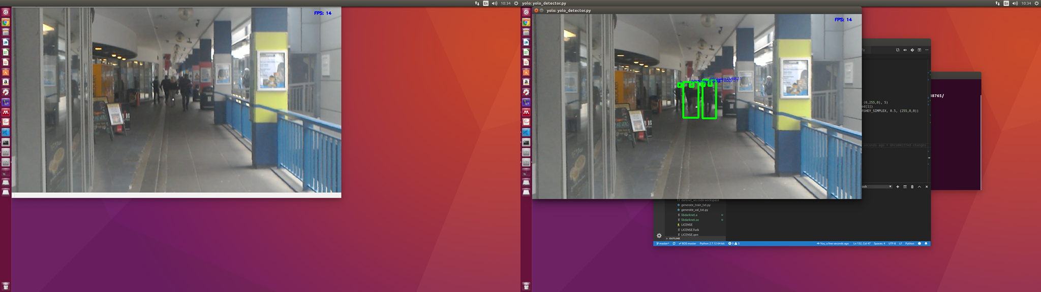
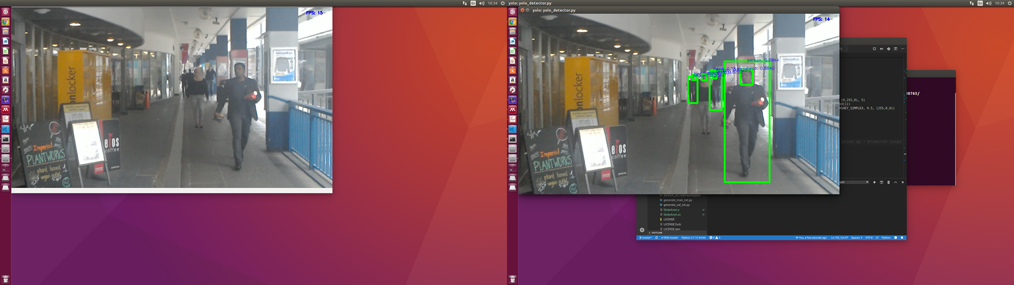
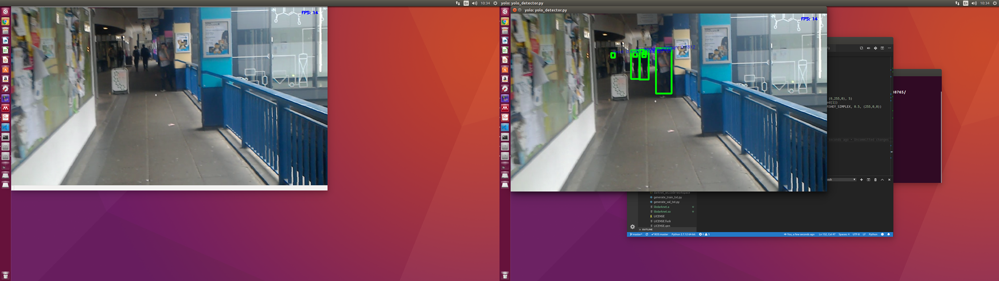

Slide 5
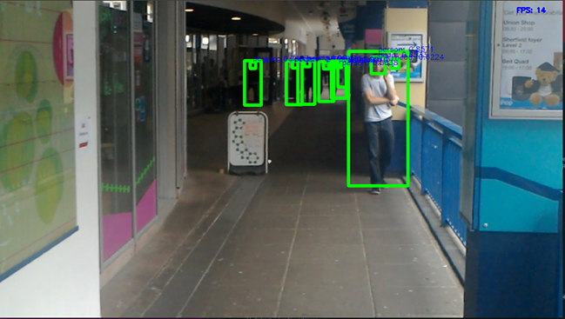

Slide 6
YOLO
YACHT
Bounding Boxes
Detector
DeepSort
Tracker
JPG Image
OpenPose
Confirmed Tracks
Unconfirmed Tracks
New Unconfirmed Tracks
Detections
NN Matching
IOU Matching
Matched Tracks

Slide 7
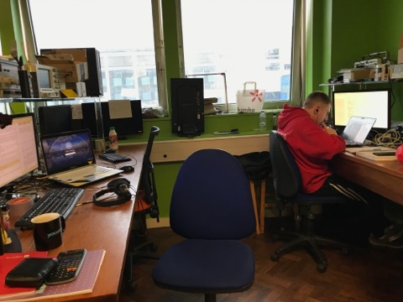
HDD System
1
YOLO
Bounding Box Detections
YACHT
JPG Image
DeepSort
Tracker
Detector
Tracking ID
OpenPose
Towards/Away

Slide 8
Vulcan CameraStream
JPG Encoding
Texture2D
BGRA32 Raw Image
Unity Texture
JPEG Image
Frames
Frame Capture
Compression
Main Thread
Render scene
ROS Publish
Frame published

Slide 9
Unity Application
/image_transport/compressed
/navigation/main_js_cmd_vel
/yacht/output/detectionids
/arta/cmd_vel
/yacht/output/detectiondirections
/arta/odom
World Manager
Hologram Manager
/detectionids/
IOU Matching
GameObject Creation
/detectiondirections/

Slide 10
